Slide 1
SOFTWARE DEVELOPMENT 🧑‍💻

Slide 2
SOFTWARE ENGINEERING
It is a Systematic, Disciplined, Cost-Effective Techniques for Software Development.
Engineer Approach to develop a Software

Slide 3
EVOLUTION phases
1945-65 – Origin : NATO(North Atlantic Treaty Organization) introduced “Software Development”(SD) word in their conference to stop the “Build and Fix Method” and start making software with proper planning and research.
1965-85 – Crisis : If 100 software’s are Build at that time only 2% are used, 50-60% are not delivered or not used and remaining were scraped due to over time or over budget or any other reason. Example: OS/360 IBM Product – Head of this software said in his book – “Multi-Millionaire Fail Project”

Slide 4
EVOLUTION phases
1990-2000 – Internet : The most famous software that is still working till now with a most heavy competition “Microsoft Windows” – System Software.
2000-2010 – Light Weight : Mobile Phones were introduced for that light weight software’s were needed so that it can run properly and smoothly.
2010-Till Now – AI, ML, DL: Artificial Intelligence, Machine Learning, Deep Learning

Slide 5
CONCLUSION
One of the best thing in the Evolution Phase is most the Software’s are now Free.

Slide 6
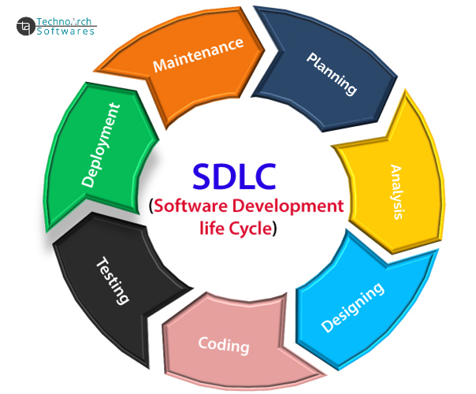
SOFTWARE DEVELOPMENT LIFE CYCLE

Slide 7
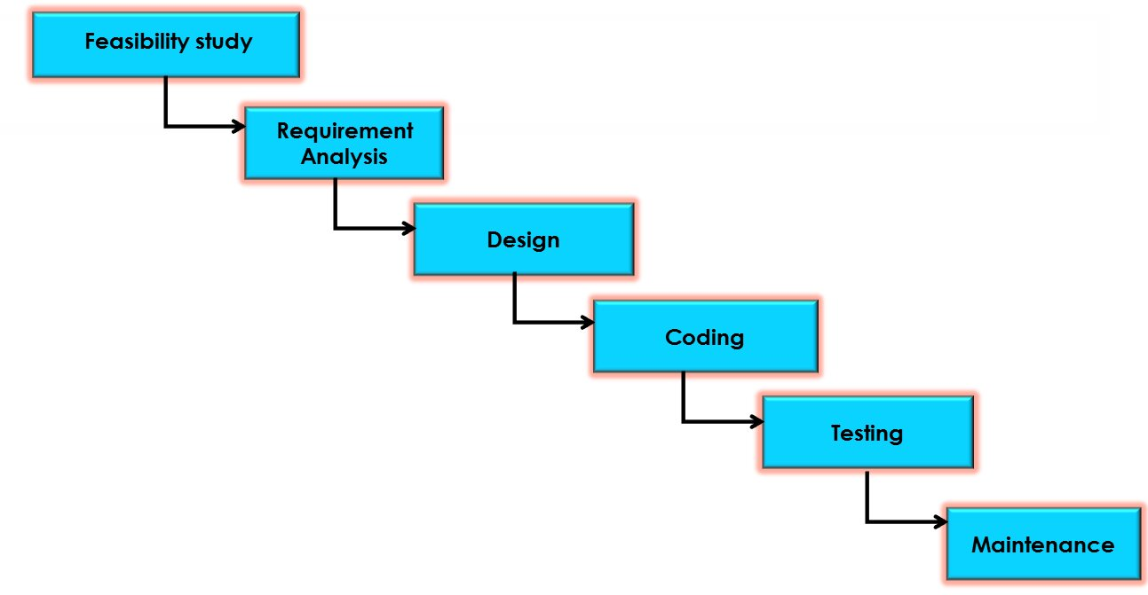
CLASSICAL WATERFALL MODEL
If the project is possible to do or not
SRS Document

Slide 8
CLASSICAL WATERFALL MODEL
Advantages | Disadvantage
1. Base Model. | Rigid (not flexible).
2. Simple and Easy. | 2. No Feedback taken from customer.
3. Suitable for small projects(means if the customer knows exactly what they want). | 3. No Testing or Experiment.
4. Phases are processed and completed one at a time. | 4. No Parallelism.
5. Well understood Milestones. | 5. 60% efforts in Maintenance Phase.

Slide 9
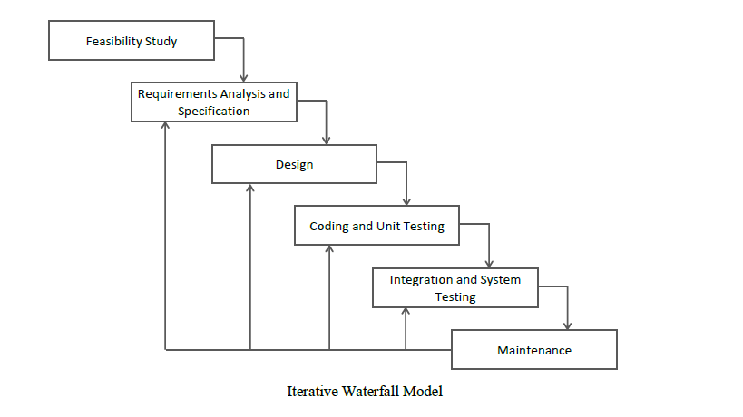
Iterative MODEL

Slide 10
Iterative MODEL
Modified version of Waterfall Mode.
Major Difference between Waterfall and Iterative Model: Iterative Model have Feedbacks i.e. one phase can give suggestions to previous phase for better modifications. Except Feasibility Study Phase – we can’t give feedback to this phase that means if once you are committed to develop a software you can’t backstep.
No Phase Overlapping – One time one phase.
No Intermediate Delivery – No Prototype can be given.
Less Customer Interaction.

Slide 11
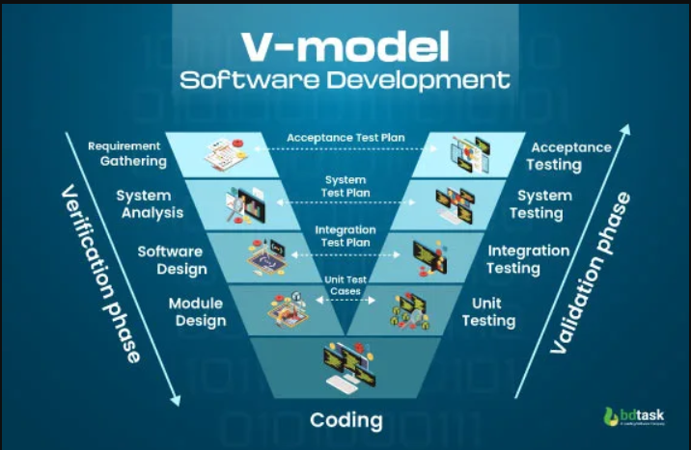
V MODEL

Slide 12
V MODEL
Known as Verification & Validation Model.
Extension of Waterfall Model.
Testing is associated with every phase of life cycle.
Verification Phase includes – Requirement Gathering, System Analysis, Software Design, Module Design.
Validation Phase includes – Unit Testing, Integration Testing, System Testing, Acceptance Testing.

Slide 13
V MODEL
Advantages:
Time Saving.
Good understanding of the project in the beginning.
Every component be testable.
Progress can be Traced easily.
Disadvantages:
No feedback so less scope of changes.
Risk analysis not done.
Not good for big or object-oriented projects.

Slide 14
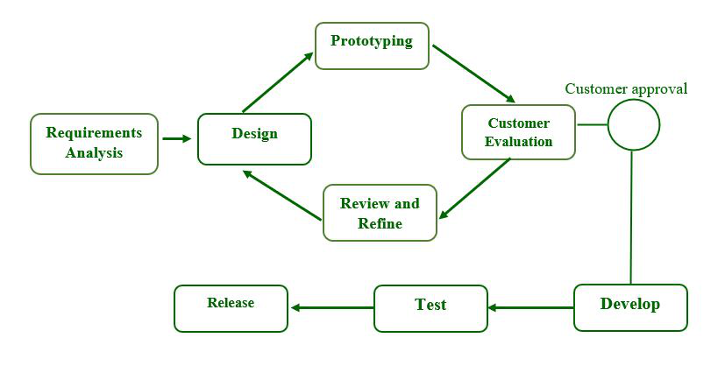
PROTOTYPE MODEL

Slide 15
PROTOTYPE MODEL
If customer is not sure/clear with the idea then use this model.
Throw away Model [If accepted then go ahead otherwise throw it].
Good for Technical and Requirement Risks.
Increase in Cost of Development [Disadvantage].

Slide 16
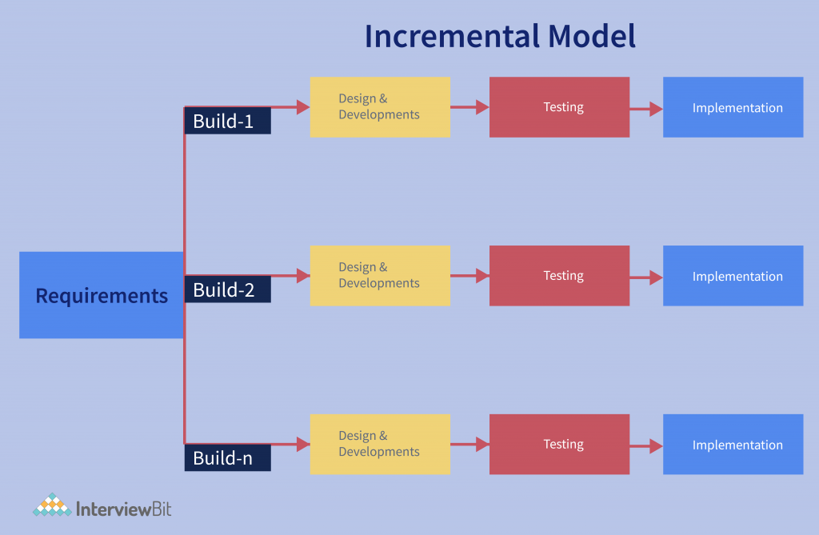
Incremental MODEL

Slide 17
Incremental MODEL
One by One Module Developed or we can say module by module working.
Customer Interaction Maximum.
Large Projects.
Early Release Product Demand.
Flexible To Changes.

Slide 18
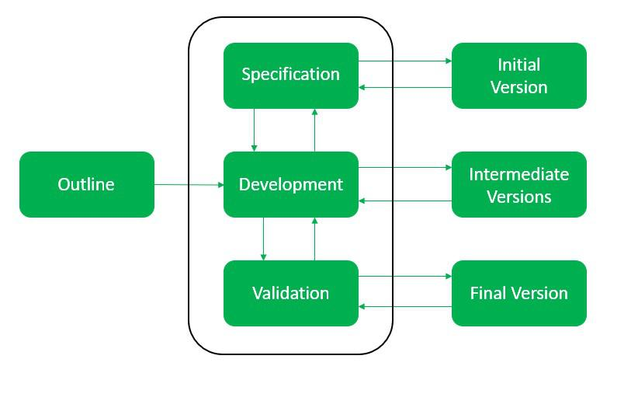
EVOLUTIONERY MODEL

Slide 19
EVOLUTIONERY MODEL
Evolutionery Model is a Combination of Iterative & Incremental Model of Software Development Life Cyle (SDLC).
Incremental Model First Implement a few basic features and deliver to the customers. Then build the next part and deliver it again and repeat this step until the desired system is fully realized no long-term plans are made.
Iterative model Main Advantage is its Feedback process in every phase.
Also Known as “Design a Little, Build a Little, Test a Little, Deploy a Little Model”.

Slide 20
EVOLUTIONERY MODEL
Advantages:
Customer Requirements are clearly specified.
Risk Analysis is better.
It Supports Changing Environment.
Initial Operating Time is Less.
Better Suited for large mission – critical projects.
Disadvantages:
High Cost
Highly Skilled resources are required.

Slide 21
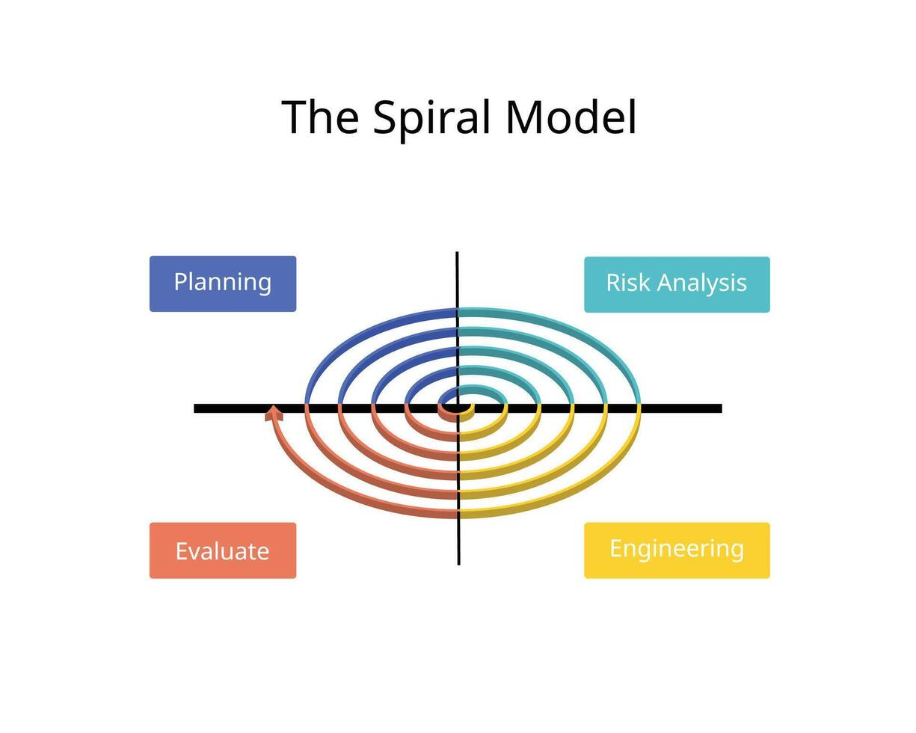
Spiral MODEL

Slide 22
Spiral MODEL
Radius of Spiral = Cost. Increase in radius = Increase in Cost.
Angular Dimensions = Progress. 180 Degree = 2 Phases. 360 Degree = 4 Phases.(1 Round Completed).
It is also Called Meta Models. Means using Multiple Models. 1)Step-By-Step working = Waterfall Model. 2)Feedback Taking = Iterative Model. 3)Prototype can be make due to Risk = Prototype Model.

Slide 23
Spiral MODEL
Advantages:
Risk Handling.
Large Projects.
Flexible.
Customer Satisfaction.
Disadvantages:
Complex.
Expensive.
Too much risk analysis.
Time.

Slide 24
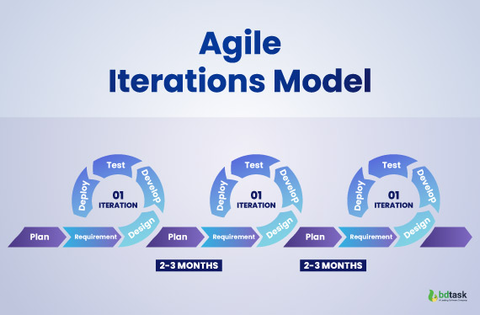
Agile MODEL

Slide 25
Agile MODEL
Latest Model.
Mostly Companies are using, for example – Amazon, Facebook.
In This Model – it divides Large Projects into small CHUNKS or we can say into small Iterations(small Pieces). Then after designing, implementing and testing it releases the Iteration and takes feedback from customers if it worked then will go ahead, it not then re-worked & modified it then Re-Release.

Slide 26
Agile MODEL
Advantages:
Frequent Delivery.
Face to face communication with client.
Flexible for changes.
Disadvantages:
Less Documentation: Agile works less on Documentation & Negotiation with customers instead of this it focuses on Implementation.
Maintenance Problem: Due to Frequently releasing updated.

Slide 27
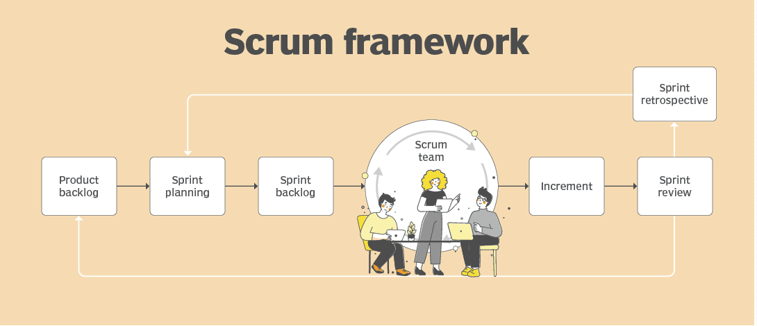
SCrum MODEL

Slide 28
SCrum MODEL
One of the most popular agile methodology.
Scrum is light weight, iterative & incremental framework.
Companies like Google, Apple, Spotify, Adobe, Microsoft & HP are using Scrum Model.
Scrum breaks down the development phases into stages or cycles called “Sprints”. [Limited Time – Maximum Power]
Sprint Duration – : Minimum – 2 Weeks, Maximum – 1 Month. Then review with the stack holders.
Manage only 1 Sprint at a time.
Scrum Team has “Run Master” who communicates with the “Product Owner” on a daily basis.

Slide 29
SCrum MODEL
KEYWORDS:-
Backlog – A form where basic Designs & Planning are mentioned.
Sprints – Small parts of a large project.
Daily Scrum – A 10-15 min Daily Meeting of Developers with Stack Holders. Then developers discuss with the team & then implements the final product.
Scrum Master – Person who monitors everything & manages Team as well as Stack Holders.
Product Owner – Client.

Slide 30
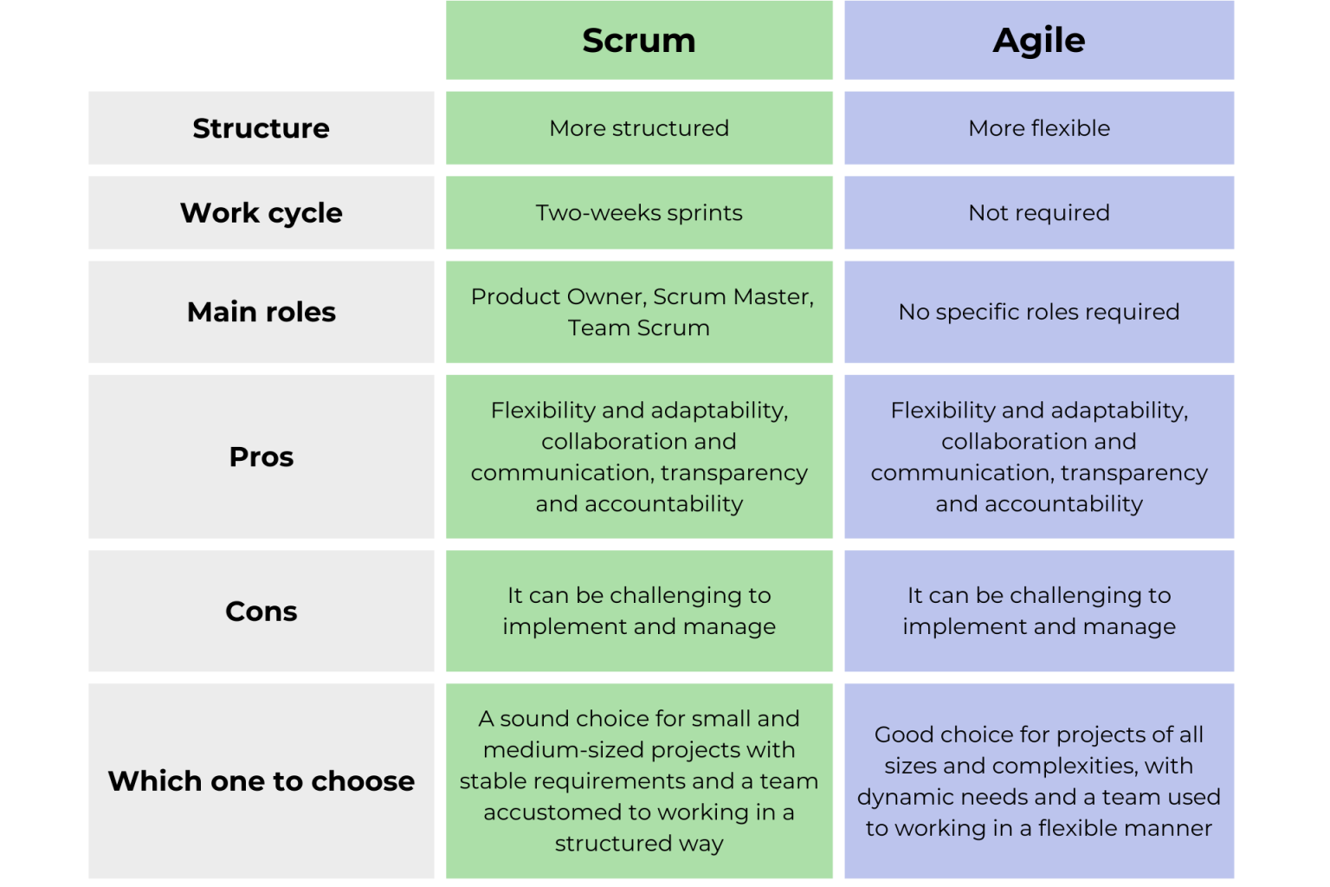

Slide 31
Model | Basic Idea | Process Type | Customer Involvement | Flexibility to Change | Risk Handling | Testing Approach | Best Suitable For
Waterfall Model | Development flows sequentially through phases (requirements → design → implementation → testing → deployment). | Linear / Sequential | Low | Very Low | Poor risk handling | Testing happens after development | Small projects with clear and fixed requirements
Iterative Model | System is developed through repeated cycles (iterations), improving the product each time. | Repetitive cycles | Medium | Medium | Moderate | Testing done in every iteration | Projects where requirements evolve over time
V Model | Extension of Waterfall where each development phase has a corresponding testing phase. | Sequential with verification & validation | Low | Low | Moderate | Testing planned in parallel with development | Systems requiring strict testing (e.g., safety-critical systems)
Prototype Model | A working prototype is built first to understand and refine requirements. | Prototype-driven | High | High | Moderate | Testing mainly on prototype and final system | Projects with unclear or changing requirements
Incremental Model | System is built and delivered in small functional increments. | Step-by-step increments | Medium–High | High | Moderate | Each increment is tested separately | Large systems needing early partial delivery
Evolutionary Model | System evolves continuously with new features based on feedback. | Continuous evolution | High | Very High | Moderate | Continuous testing as system evolves | Projects where requirements are not well defined
Spiral Model | Combines iterative development with risk analysis in each spiral cycle. | Risk-driven iterative cycles | High | High | Excellent risk management | Testing in every spiral phase | Large, complex, and high-risk projects
Agile Model | Development is done in small iterations with frequent delivery and customer feedback. | Iterative & incremental | Very High | Very High | Good risk management | Continuous testing and integration | Dynamic projects with frequently changing requirements
Scrum Model | Agile framework using short cycles called sprints with defined roles and ceremonies. | Agile framework with sprints | Very High | Very High | Good risk handling | Testing done within every sprint | Team-based projects requiring rapid delivery

Slide 32

PPT BY – Prof.Vivek Bhati

